Slide 1

More Key Concepts
Class 3
Larry Swatuk
lswatuk@mta.ca

Slide 2
Key terms and concepts from Week 1
EIA
Socio-ecological system
Monitoring and evaluation (M&E)
Ramsar Convention (on Wetlands of International Importance)
Endorheic and Exorheic systems/ flood pulse environment
Flood recession agriculture
Strategy (as in strategic planning)
Stakeholder

Slide 3
Key terms and concepts (continued)
Nature/natural world
Biosphere/environment
Eco/bio/anthropocentric perspective
Best practices in natural resources management
Conflict resolution and negotiation
Justice/equity/sustainability
Multidisciplinary/interdisciplinary
Ephemeral and perennial rivers
Bimodal rainfall regime

Slide 4
Stakeholder Mapping
Stakeholder mapping is the systematic identification, characterization, and analysis of all actors who affect, are affected by, or have authority, knowledge, or interests related to natural resource management decisions, in order to design legitimate, effective, and durable policy and planning processes.
In natural resource management, stakeholder mapping is foundational because resources are:
Shared across space and time
Governed by multiple authorities
Embedded in social, cultural, ecological, and economic systems
Sites of power, inequality, and conflict

Slide 5

Remote Area Dweller
Urban Shack Dweller
Ordinary citizen?
Civil Society
National, International
Private Sector
IFIs
Central State
Donor States
INGOs

Slide 6
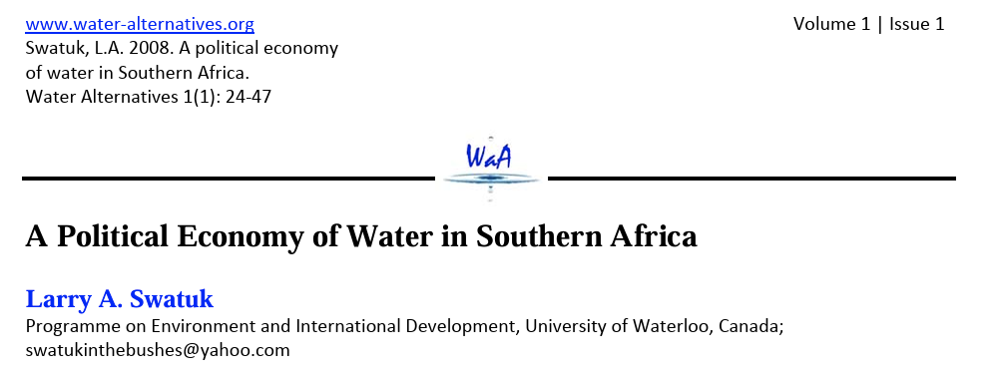
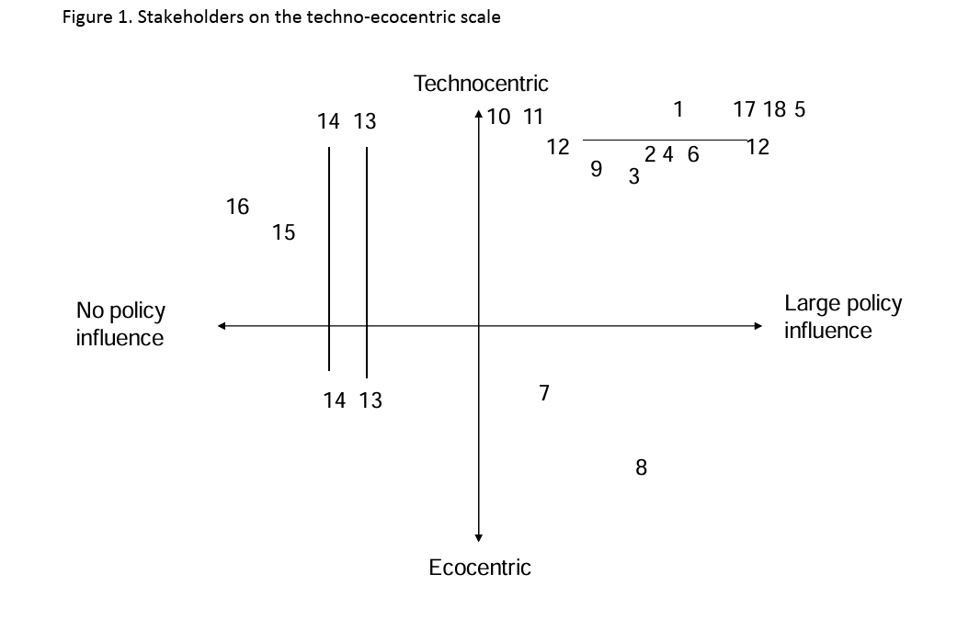

Slide 7
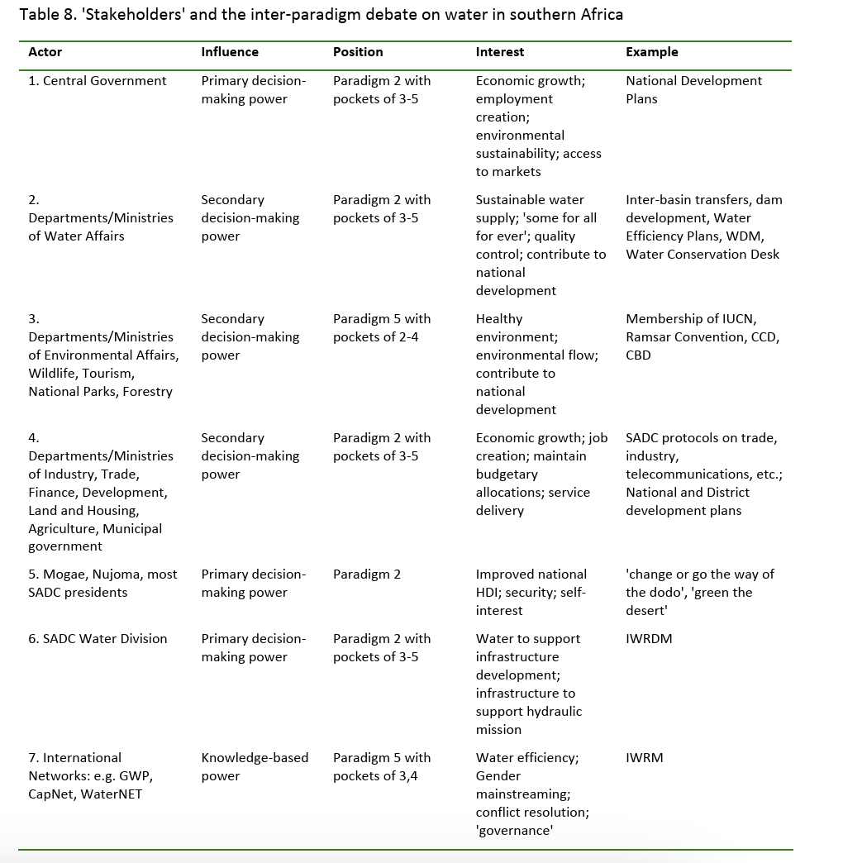

Slide 8
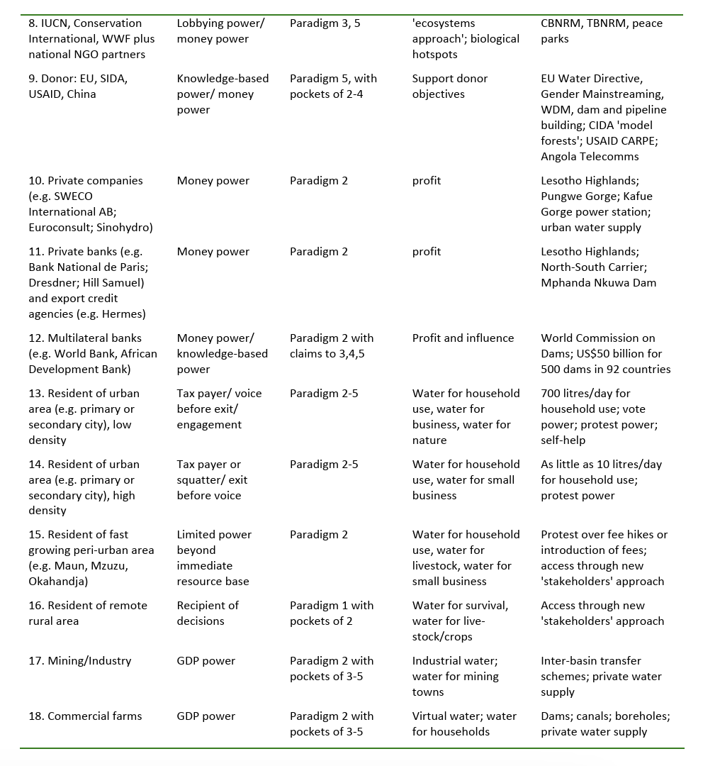

Slide 9



Slide 10
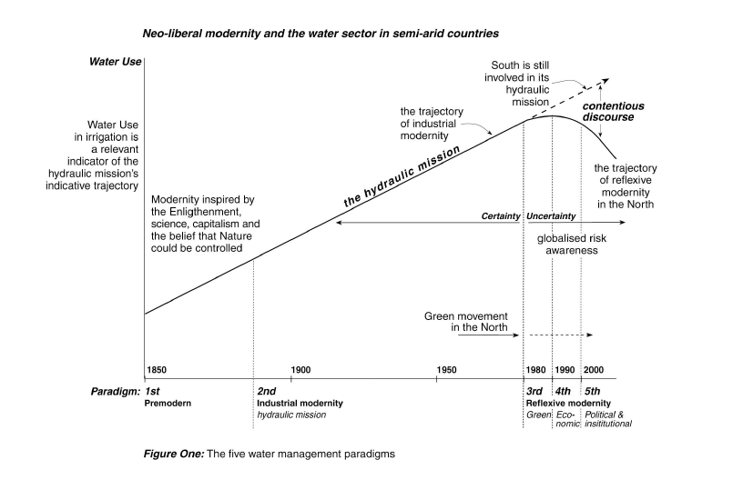

Slide 11
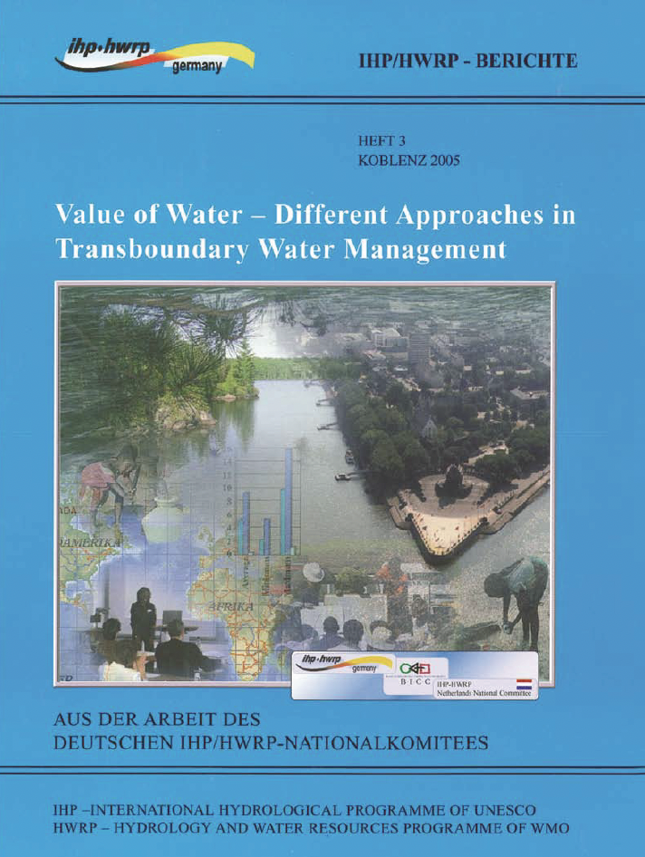
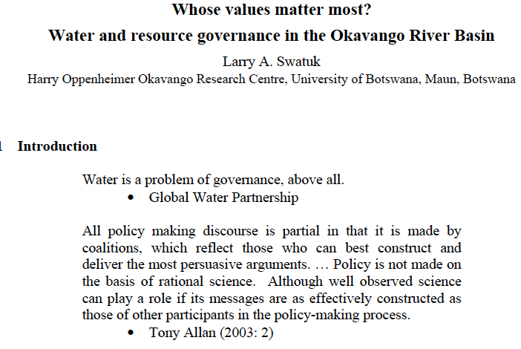

Slide 12
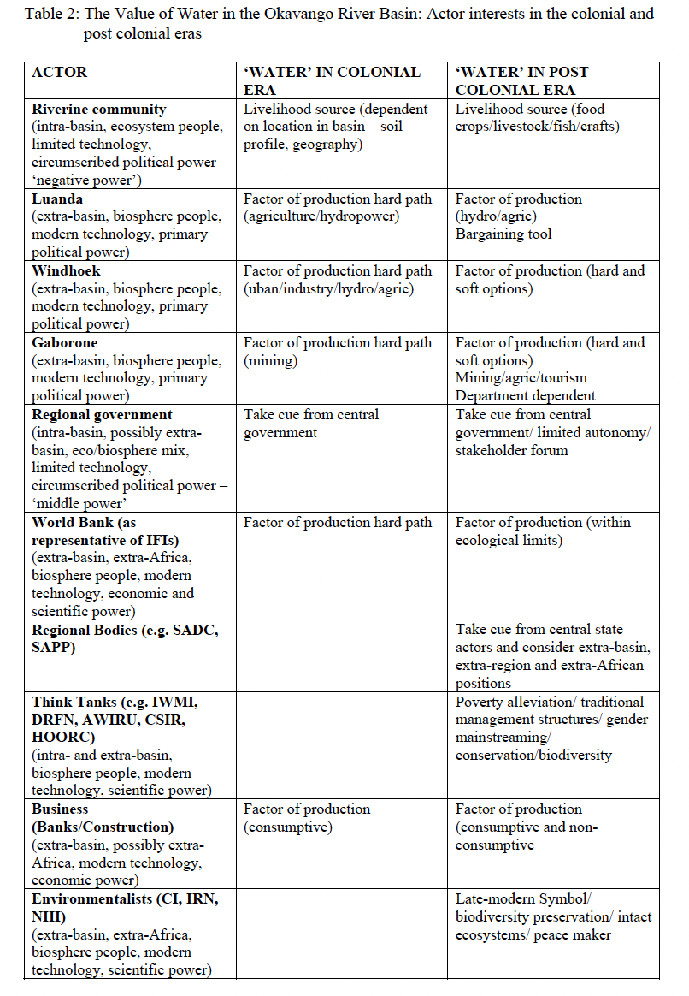
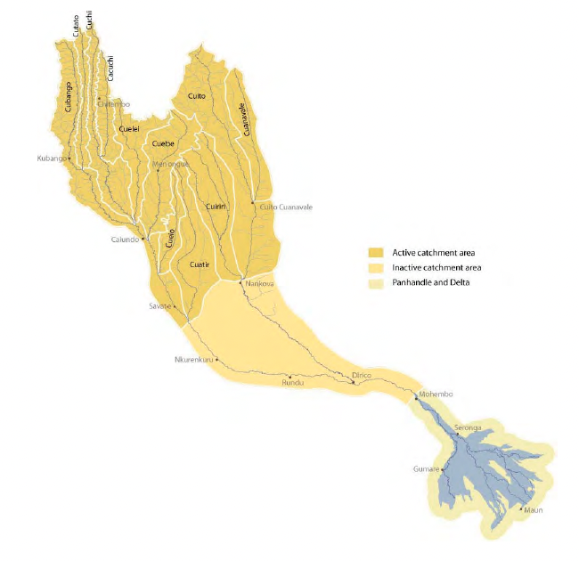

Slide 13

A checklist
Stakeholder
Stakeholder mapping
‘isms’ (anthropomorphism, ecocentrism, biocentrism)
Nature/Natural World
Environment/Biosphere
Natural Resources
Technocentric/Ecocentric
Paradigms
Ecosystem people/Biosphere people

